Slide 1
B2L2
Block 2 Lektion 2

Slide 2
Relational Databases
And how they differ from NoSQL databases

Slide 3
Topics in this Module
Structured, semi-structured, unstructured data
Vertical (scaling up) & Horizontal scaling (scaling out)
Relational (SQL) vs Non-relational data (NoSQL)
Normalisation
SQL Joins
SSMS Database diagrams (ERD)

Slide 4
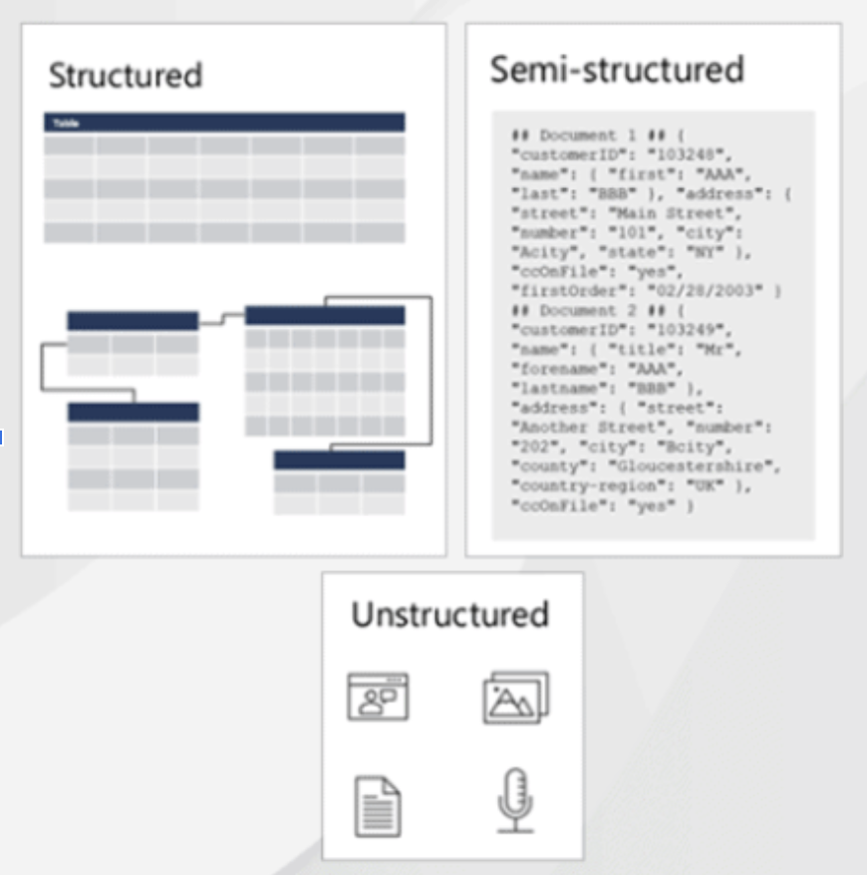
Structured, Semi-structured and Unstructured Data
Structured Data
Tables (rows & columns)
Cardinal relationships (data in one table relates to data in another table)
Semi-structured
.json
.xml
.csv
Unstructured
Machine generated/encoded e.g:
.png
.mp3
.mp4
.pdf

Slide 5
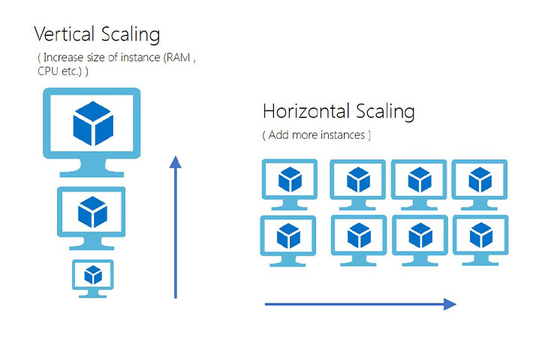
Vertical Scaling - SQL databases scale up well
Throughput: Typically measured in transactions per second (TPS) or transactions per minute (TPM). measures the overall performance a system. Throughput can be a bottleneck when in comes to database CRUD scenarios.
Throughput depends on the following factors:
The specifications of the host computer
The processing overhead in the software
The layout of data on disk
The degree of parallelism that both hardware and software support
The types of transactions being processed

Slide 6
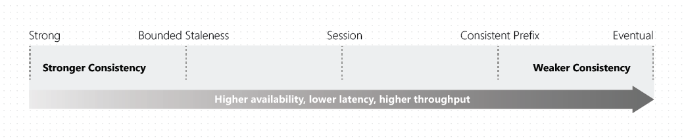
Horizontal Scaling (database replication) - Not ideal for an SQL DB
Database Throughput bottleneck addressed by
Partitioning/sharding across multiple machines (Each partition holds different tables)
Consistency is maintained at the cost of increased read latency
Increased capacity for write operations
Read operations such as joins become expensive as multiple machines are involved.
Risk: operation failure: deadlock (If multiple updates for a row do not come from the same connection - each partition has its own connection - it would cause blocking or deadlocks)- (roll-back with stored procedures)
Replication
entire db is replicated (redundancy = increased fault tolerance) at the cost of consistency (unless we enforce higher consistency level)
Write operations become expensive as we must write to every database instance.

Slide 7
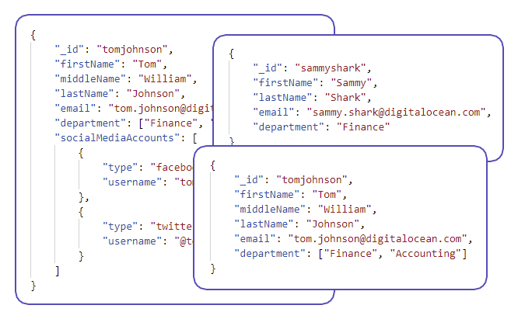
SQL vs NoSQL (Relational vs Non-relational)
NoSQL: availability over consistency
Large data quantities, faster write/read, document schema may change over time
Non-relational and schemaless, more flexible but increases application responsibilities (e.g. handle “joins” & consistency scenarios).
easier to scale horizontally, allowing for increased reliability (availability & resiliency ), frequent changes,
NoSQL: BSE (BASE)
Basic Availability
Low consistency allows for high availability
Soft State
Doesn’t have to be write consistent, may serve “older state”
Eventual Consistency
Availability over consistency (at some point it will likely be consistent)
NoSQL - complex unstructured data: document, keyvalue pairs, graph, cache (data in memory) etc for large dataquantities
NoSQL document (json object) example - notice the variation between documents

Slide 8
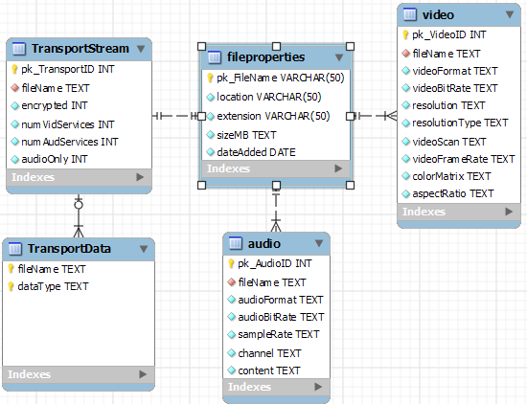
Structured data
Example: Structured way of storing metadata about Blob (stored in object storage)
SQL: Consistency over availability
Banking & online transactions. Registering customers, employees, software licenses etc.
SQL: ACID
Atomicity: A field holds only one value. Transaction must complete or revert to previous state (money never lost) - success else rollback
Consistency: Constraints to enforce data states (only allowed values: not null, length etc)
Isolation: Concurrent execution safe (ensures sequential transaction outcome)
Durability Data is persisted in non-volatile (safe from crash/power loss) memory e.g. SSD/HDD (NVS Devices).

Slide 9
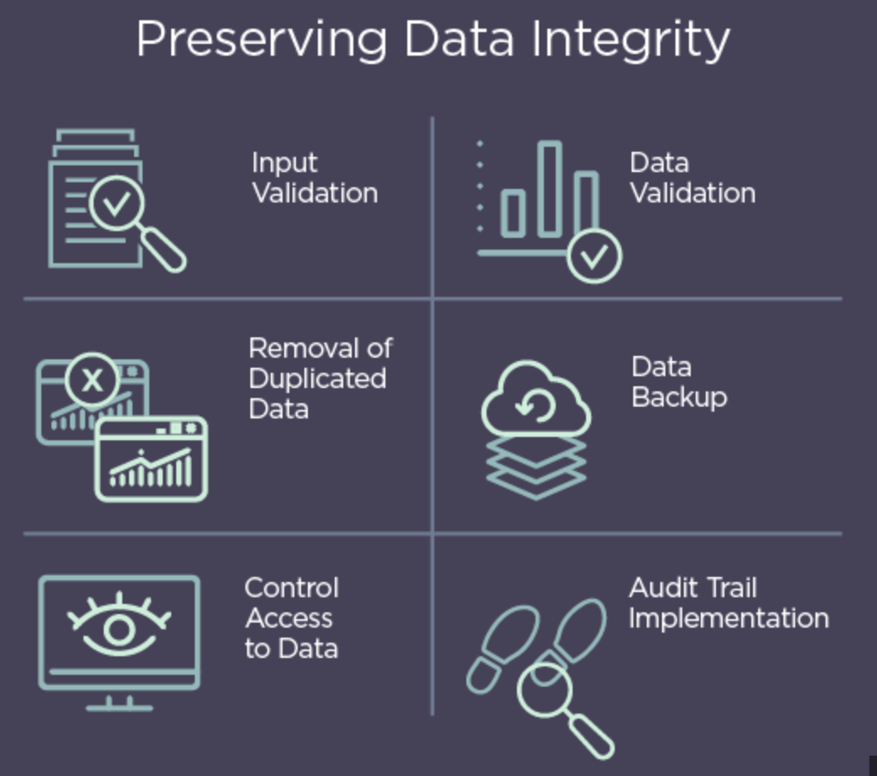
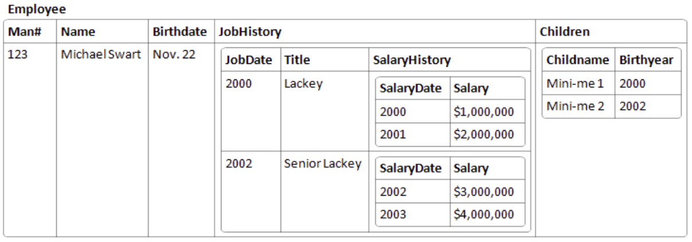
Normalisation - reduces application responsibilities
Normalisation mitigates data redundancy and inconsistent dependencies and facilitates maintaining data integrity (see image) e.g. a person cannot have two dates of birth.
Each step in the mitigation process entails applying a rule (from 1st - 6th Normal form)
“Fully normalised“ data is easy to work with, easy to interpret, easy to control access etc!
Consider the following example (non-normalised data) in the table below:
Probably the only time you’ll see data structured this way :-). 3NF is considered standard and fully normalised in most scenarios

Slide 10

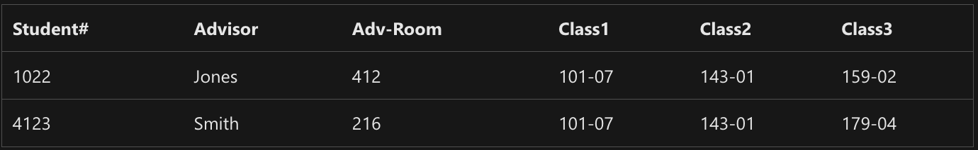
From this…

Slide 11

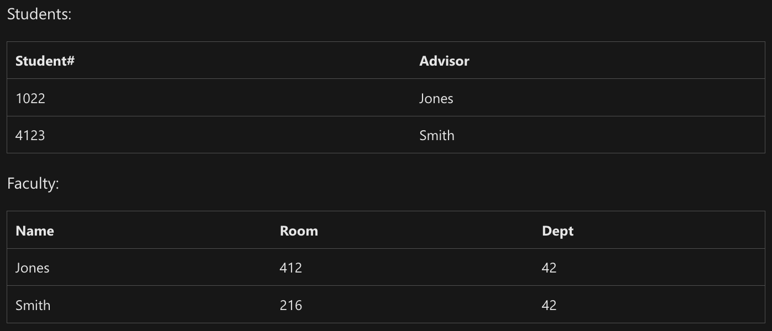
To this…

Slide 12

Code Along
Let’s explore the concept of
Normalisation together!

Slide 13
JOINS

Slide 14
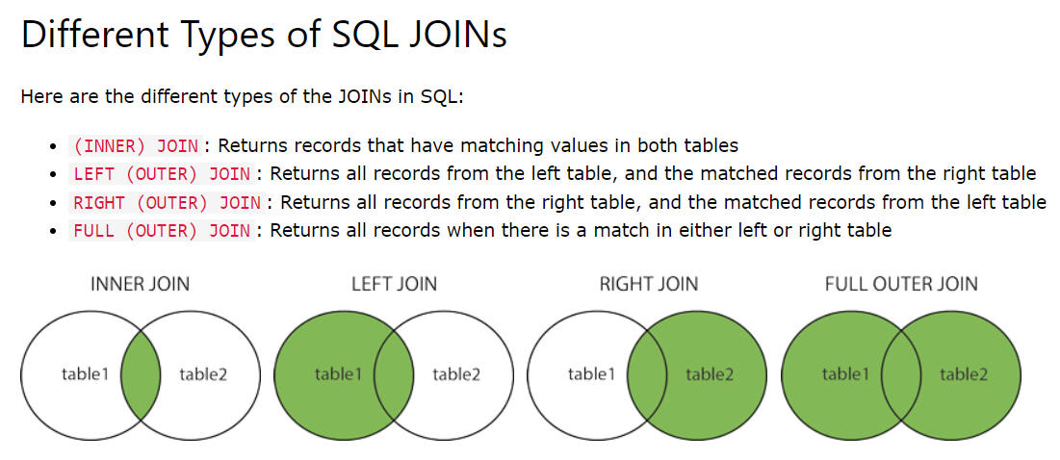
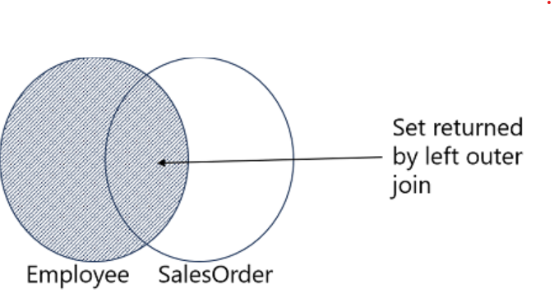
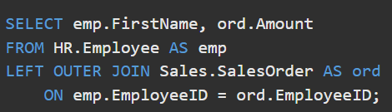

Slide 15
SSMS Database Diagrams (Entity Relationship Diagrams)

Slide 16
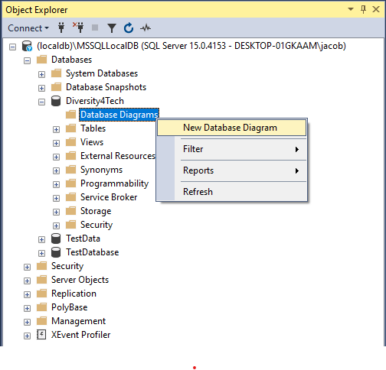
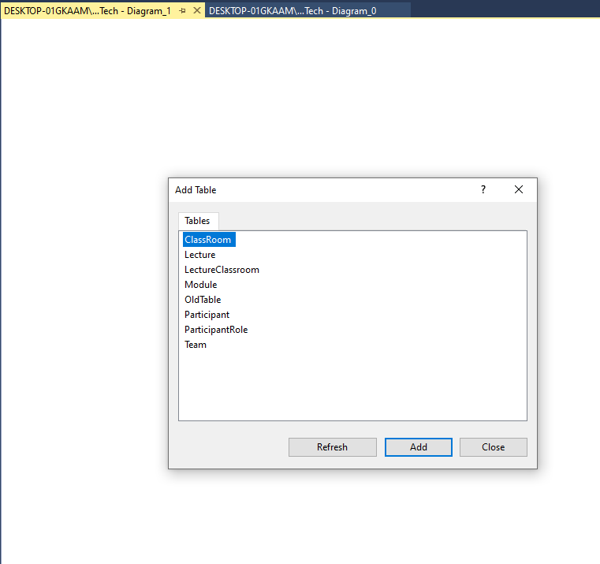

Slide 17
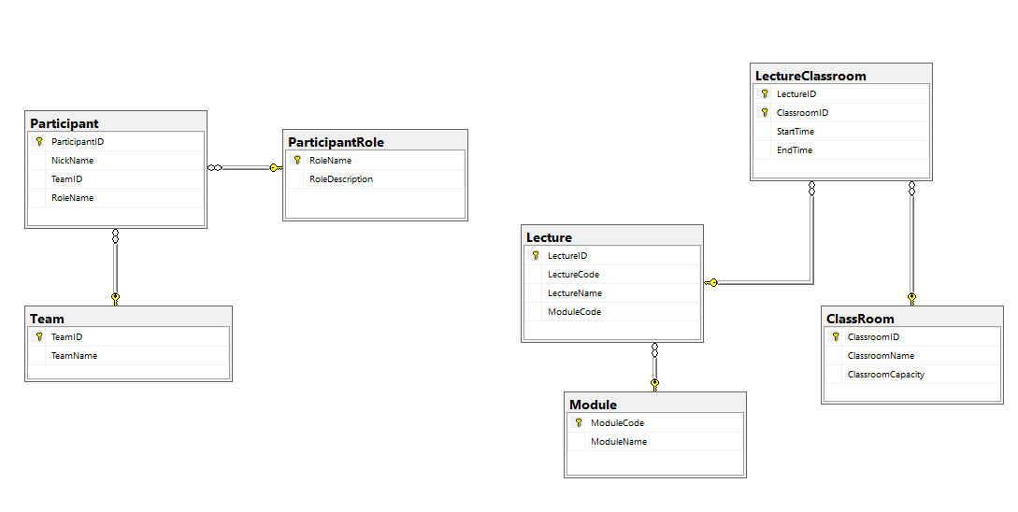

Slide 18

Further Reading
Structured vs. Unstructured Data: What’s the Difference? | IBM
Relational vs. Non-Relational Databases
SQL vs. NoSQL: What's the difference?
Database normalization description - Office | Microsoft Learn
Database Normalization – Normal Forms 1nf 2nf 3nf Table Examples
Primary and Foreign Key Constraints - SQL Server | Microsoft Learn
Create Foreign Key Relationships - SQL Server | Microsoft Learn

